Slide 1

Conditionals - if's
Lecturer
Edvinas Kesminas
Data

Slide 2
Today you will learn
Conditionals - if's
Conditionals - If, elseif, else
NOT(!) logical operator
01
04
Relational operators
Logical operators
02
05
Bool clause
03

Slide 3


Conditionals - If, elseif, else
Conditionals - if's
The C# programming language has a very useful feature called the "if clause".
It allows the software to make decisions based on whether a condition is true or false.
The C# if clause is very attractive to novice programmers because it allows them to create simple but efficient pieces of code.

Slide 4




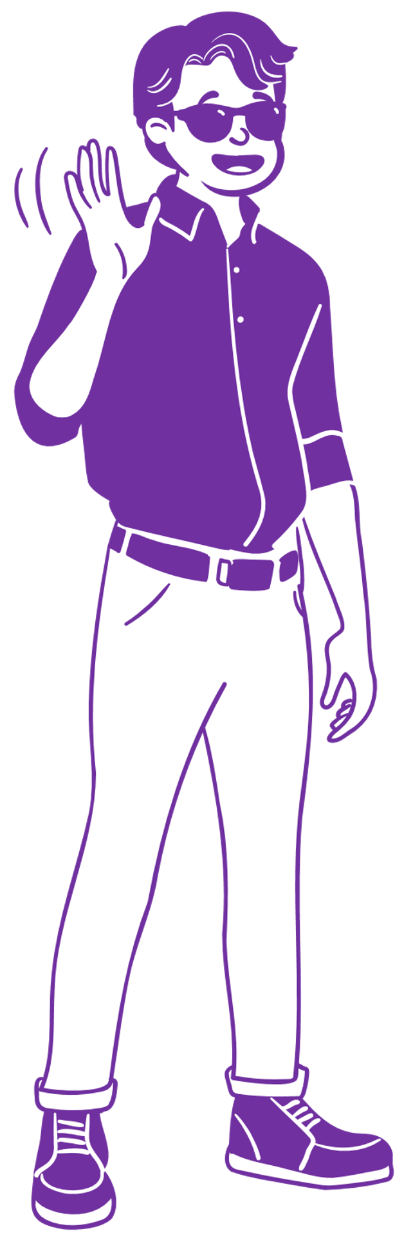
Conditionals - If, elseif, else
Conditionals - if's
The C# if clause works in a similar way to how we make decisions in life. It can be compared to moments of choice, where we take different actions depending on the circumstances.
For example, if(if) the weather is sunny, we may decide to go outside for a walk. But(elseif) if it's raining, then we might be better off staying indoors and learning to code.
C# if clauses also allow programs to make decisions according to certain criteria that are consistent with the programmer's logic.

Slide 5


Conditionals - If, elseif, else
Conditionals - if's
There are many real-life analogies to help you understand how the C# if clause works.
Thinking about education, you can imagine that if (if) a student has an average of more than 9, he or she will get a perfect grade.
If(elseif) his average is between 8 and 9, he will get a good grade.
However, if(else) his average is less than 8, he will get a mediocre grade.
This condition reflects the logic of C# programming, where different actions can be defined when certain conditions are met.

Slide 6

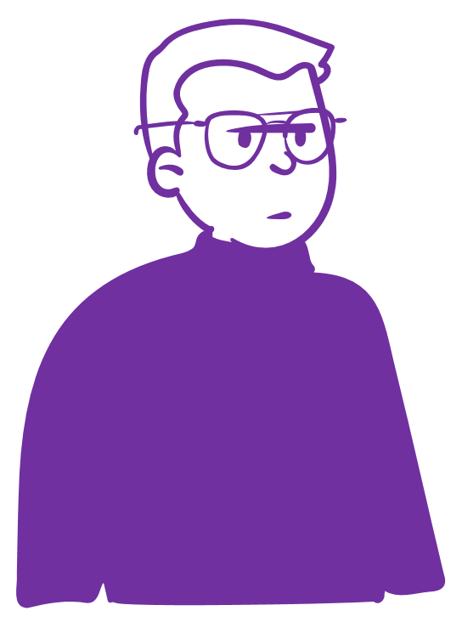

Conditionals - If, elseif, else
Conditionals - if's
The C# if clause can also be useful for procurement.
If(if) the price of an item is less than €50, we can buy it.
However, if the price is between €50 and €100, we may consider buying.
If(else) the price is more than $100, it may be better not to buy this product.
Here we can see the C# if-condition principle, which allows actions to be taken based on whether or not the relevant conditions are met.

Slide 7


Conditionals - If, elseif, else
Conditionals - if's
The If condition supports:
Variables of type Bool
Relative operators ==, !=, >, <, <=, >=
Logical operators NOT(!), AND(&&), OR(||), XOR(^)

Slide 8
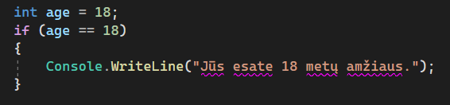
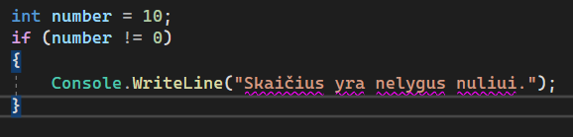
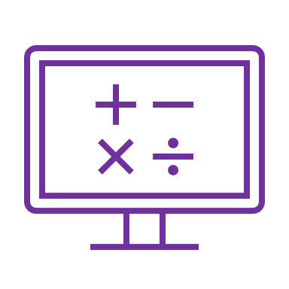
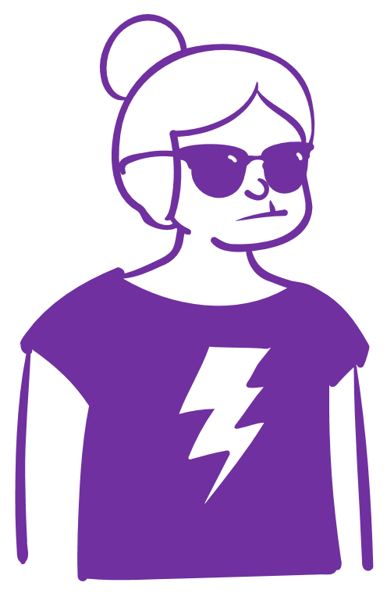
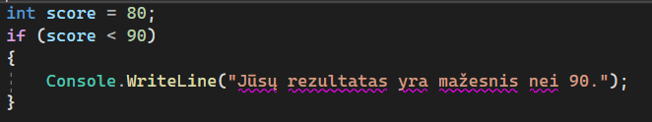
Relational operators
Conditionals - if's
The If condition supports:
Relational operators ==, !=, >, <, <=, >=

Slide 9
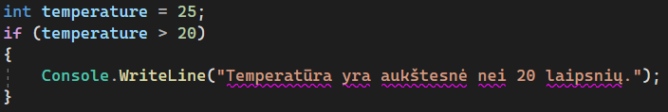

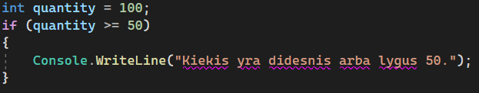

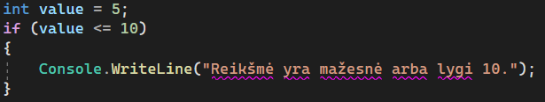
Relational operators
Conditionals - if's
The If condition supports:
Relative operators ==, !=, >, <, <=, >=

Slide 10
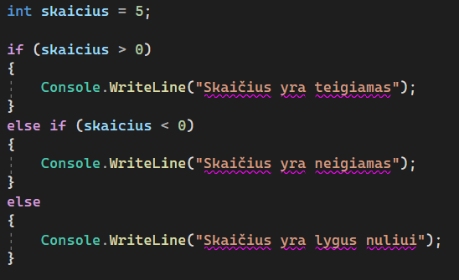
Conditionals - If, elseif, else
Conditionals - if's
Write a C# program to check if the number you enter is positive. If the number is positive, output the message "The number is positive". If the number is negative or zero, output the message "The number is negative or zero".

Slide 11
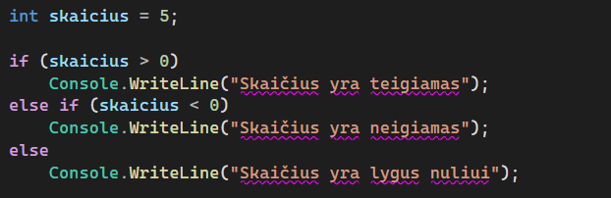
Facilitating a single line operation without using {}
Conditionals - if's
Write a C# program to check if the number you enter is positive. If the number is positive, output the message "The number is positive". If the number is negative or zero, output the message "The number is negative or zero".
Note that the example on the right is the same except that {}

Slide 12

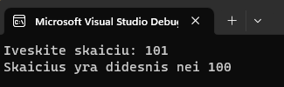

Conditionals - if's
Task 1
Write a C# program to check whether a number entered by the user is greater than 100. If so, output the message "The number is greater than 100". Otherwise, check if the number is equal to 100. If yes, output the message "The number is equal to 100". If neither condition is met, output the message "The number is less than 100".
Write a C# program to check the day number entered by the user. Based on the day number, output the corresponding message indicating the day of the week (1 - Monday, 2 - Tuesday, etc.). If the day number entered is not between 1 and 7, output the message "Incorrect day number".

Slide 13
Conditionals - if's
Task 2
Write a C# program that checks whether a number entered by the user is even or divisible by 5. Output the message "The number is even" or "The number is divisible by 5" respectively. If neither condition is met, output the message "Number does not meet any conditions".
Write a C# program to check the temperature entered by the user. Based on the temperature value, output a message about the weather conditions (temperature below 0 - "Cold", temperature between 0 and 20 - "Cool", temperature above 20 - "Hot").

Slide 14
Conditionals - if's
Task 3
Write a C# program that asks a user what time they got up in the morning. Based on the hour value entered by the user, output the corresponding greeting message (in the morning until 12 o'clock - "Good day!", from 12 to 18 o'clock - "Good afternoon!", from 18 to 24 o'clock - "Good evening!").
Write a program that asks the user to enter a password and verifies the input. If the password entered matches the password you created (in a variable), the program should output "You have successfully logged in". If the user enters "Mellon" the program should also display "You have successfully logged in". If the user enters "01101001 01101110" the program displays "Hacked..". All other options should return "Password is incorrect, please try again.."

Slide 15
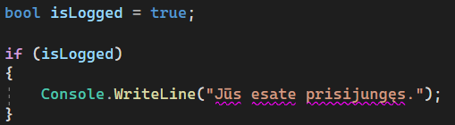
Bool clause
Conditionals - if's
This application contains a variable of type "bool" called "isLogged" which indicates whether the user is logged in.
The "if" clause of the condition checks whether the value of the "isLogged" variable is "true".
If yes, then the code between the brackets is executed, which in this case is the message "You are logged in.".

Slide 16
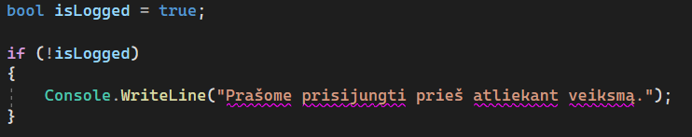
NOT(!) logical operator
Conditionals - if's
In this example you can see when we apply the code from the previous slide, but all we have to do is put a simple "!" exclamation mark and we turn the logic on its head.

Slide 17
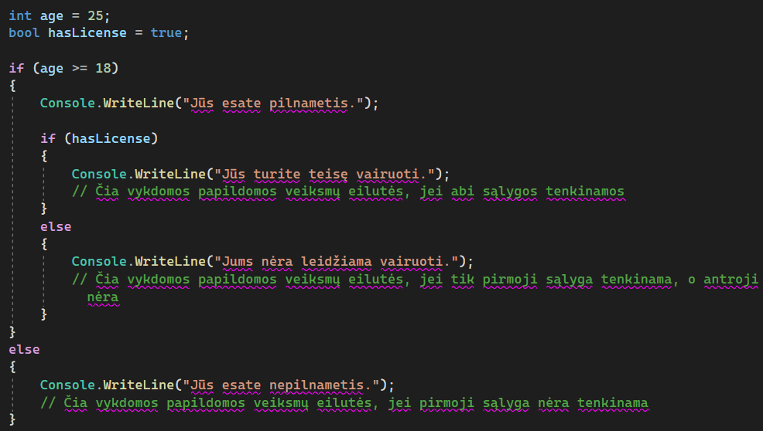
Nested If's
Conditionals - if's
On the right, we have an example where we can perform checks inside an if. In other words, we can do as many if-checks inside other ifs as we need, but be careful, because beyond 3 ifs the code quickly becomes hard to read and maintain.

Slide 18
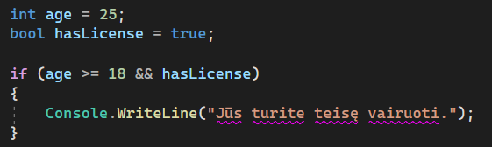
Logical operators &&
Conditionals - if's
This program contains the variables "age" and "hasLicense".
The "&&" operator is used inside the "if" clause of the conditional to check whether the "age" value is greater than or equal to 18 and whether the "hasLicense" value is "true".
Only if both of these conditions are met, then the code between the brackets is executed, which in this case is the message "You have the right to drive.".

Slide 19
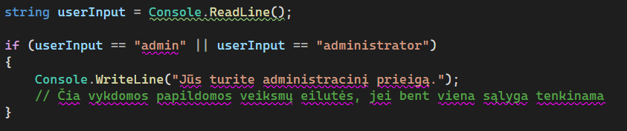
Logical operators ||
Conditionals - if's
This application uses a variable of type "string" called "userInput" into which the value entered by the user is read.
The "||" operator is used inside the "if" clause of the conditional to check whether the value of "userInput" is equal to "admin" or "administrator".
If at least one of these conditions is met, then the code between the brackets is executed, in which case the message "You have administrative access." is displayed.

Slide 20
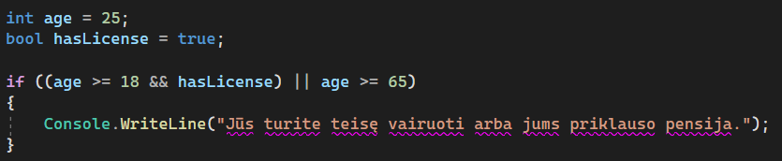
Logical operators && and || and ()
Conditionals - if's
This program contains the variables "age" and "hasLicense". The "&&" (and) and "||" (or) operators are used inside the "if" clause.
This sentence will check whether at least one of the two conditions is met.
The first condition checks whether the "age" value is greater than or equal to 18 and whether the "hasLicense" value is "true".
The second condition checks whether the "age" value is greater than or equal to 65.
If at least one of these conditions is met, then the code between the parentheses is executed, which in this case would output the message "You are entitled to drive or you are entitled to a pension".

Slide 21
Conditionals - if's
Task 4
Write a C# program that checks the age entered by the user and outputs the correct message according to the following logic:
If you are under 18, display the message "You are a minor".
If the age is between 18 and 65, display the message "You are an adult". (Using &&)
If your age is 65 or over, display the message "You are eligible for the Senior Citizen promotion".

Slide 22
Conditionals - if's
Task 5
Write a C# program that checks the number of years entered by the user and determines whether it is a leap year according to the following logic:
If the year is divisible by 4 but not by 100 or divisible by 400, output the message "This is a leap year".
Otherwise, display the message "This is not a leap year".

Slide 23
Conditionals - if's
Task 6
Write a program under the condition: if a number is divisible by 3 and 5 without remainder, that is, it is divisible by both numbers, the program outputs "BazingaPop". If the number is divisible by 3 only, without remainder, it outputs the word "Bazinga". If the number is divisible only by 5 without remainder, the word "Pop" is output. Otherwise, if the number does not satisfy any condition, the number itself is output.

Slide 24
Conditionals - if's
Task No 7
Write a program that asks the user to enter two numbers. If both numbers are positive, output the message "Both numbers are positive". If only one of the numbers is positive, output the message "Only one number is positive". If neither number is positive, output the message "Neither number is positive".
Write a program that asks the user to enter three numbers. If all three numbers are equal, output the message "All numbers are equal". If at least two numbers are equal, output the message "Two numbers are equal." If none of the numbers are equal, output the message "None of the numbers are equal."

Slide 25
Conditionals - if's
Task No 8
Write a program that asks the user to enter the values of three numbers a, b and c. Check that at least two of the numbers are positive. If so, calculate their sum and output it. If only one or none of the numbers is positive, output the message "Could not calculate sum.
Write a program that asks the user to enter the year and month. Check that the month entered is January, February or March. If it is, display the message "Cold period". Check whether the month entered is June, July or August. If yes, output the message "Hot period". Otherwise, output the message "Medium period month".

Slide 26
Conditionals - if's
Task No 9
Write a program that asks the user to enter three different numbers representing the length of the sides of a triangle. Check whether these numbers can form a triangle according to the triangle inequality theorem: any two side lengths must be greater than the remaining side length. If the condition is satisfied, display the message "Can form a triangle". If the condition is not satisfied, output the message "Cannot form a triangle".

Slide 27
Conditionals - if's
Task 10
Create a program that prints 3 products with their prices assigned. The program should allow you to add 2 products to your basket.
If a user buys 2 identical products in a basket, the basket receives a -10% promotion.
After adding 2 products, the app should ask the user if they have a loyalty card before printing the receipt. If the user has a loyalty card, the basket receives an additional -10% promotion.
Additional:
Make it so that when you buy 2 products, only 2 products are bought instead of the basket getting the promotion.
(Just analyse how this problem could be solved with the knowledge you have)

Slide 28
Conditionals - if's
Project No 11
Create a text game on a theme of your choice, e.g. mazes, zombies, Pokémon, etc.
When the application is activated the user should see an initial text explaining what the theme is and instructions for the game, pressing any key should start the game. The game should allow the user to choose from 2 possible options e.g.: By pressing 1 the user goes from the maze to the underworld where he finds a minotaur.
Additional:
Create a logo, change the colours or the font according to the mood of the game at the time.

Slide 29

Conditionals - if's
References
https://learn.microsoft.com/en-us/dotnet/api/system.decimal.tostring?view=net-7.0
https://learn.microsoft.com/en-us/dotnet/csharp/language-reference/operators/null-coalescing-operator
https://learn.microsoft.com/en-us/dotnet/csharp/language-reference/builtin-types/nullable-value-types
https://learn.microsoft.com/en-us/dotnet/csharp/language-reference/operators/null-forgiving

